Slide 1
Unity – More Code

Slide 2
Review
Must have a GameObject
Code is a component
Add component to GameObject
Select “script” from component list
C# is scripting language
Click “create..”

Slide 3
Review - Start
This method happens once at the beginning of the movie
Use Debug.Log(“put string in here”) to write a message out to the console.

Slide 4
Review - Update
This method happens repeatedly
This method can access all of the variables defined outside of the methods but inside the class
We will call these variables “Global variables”

Slide 5
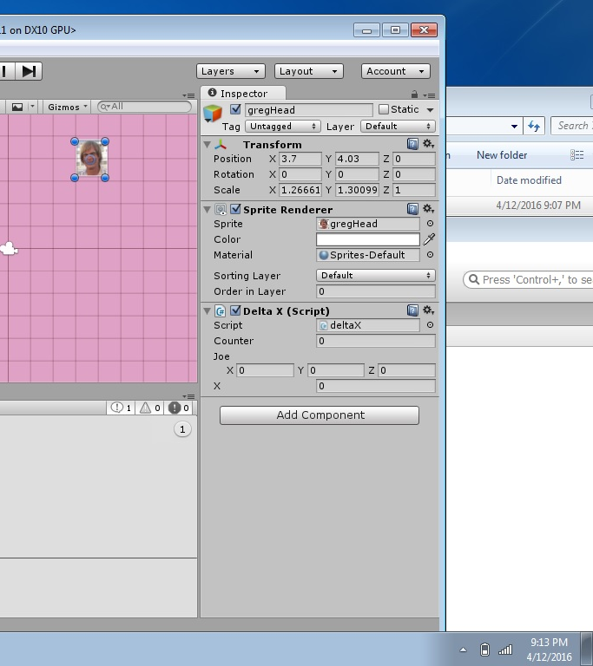
public Vector3 joe;

Slide 6
transform.position

Slide 7
Example
The following code, moves the GameObject to the transform position
X = 5.0
Y = 5.0
Z = 5.0
Note the “f” after the number. This means “float”.
“float” means there is a decimal point in the number

Slide 8
using UnityEngine;
using System.Collections;
public class deltaX : MonoBehaviour {
public Vector3 joe;
void Start () {
joe = new Vector3(5.0f, 5.0f, 5.0f);
transform.position = joe;
}
void Update () {
}
}

Slide 9
“float” Type
A “float” is a number with a decimal point.
In Unity, you must put “f” after the number.
You can define “float” variables
For example,
float sue = 1.0f;

Slide 10
Lab
Write the necessary code to make your GameObject move across the screen horizontally.
Make the motion slow

